Slide 1
Enzymes
IRSC
General Biology I Lab

Slide 2
Metabolism
All the chemical reactions that occur in a cell
A + B  C + D
Reactants Products
Substrate
These reactions can take a long time – an enzyme is needed to speed the reaction and to lower the activation energy needed to jumpstart the reaction

Slide 3
What are Enzymes?
Organic catalysts that speed metabolic reactions
Some very important metabolic processes would take years to occur if enzymes weren’t involved
Cells don’t have years to perform these metabolic processes ☺
Most are proteins
Therefore, they can be affected by pH and temperature
Enzymes are specific and speed only one type of reaction
Names for enzymes usually end in -ase

Slide 4
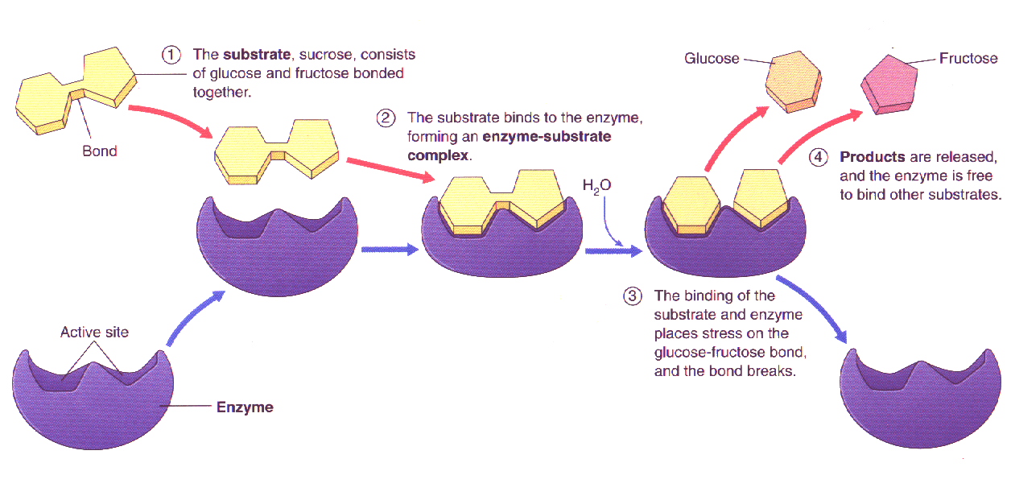
Example of catabolic reaction involving an enzyme;
Enzymes can also be involved in synthesis reactions
http://lhs2.lps.org/staff/sputnam/Biology/U4Metabolism/enzyme.gif

Slide 5
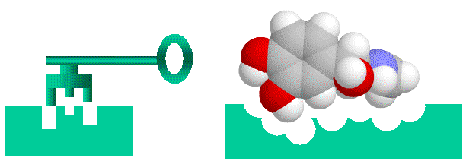
Effects of Concentration of Enzyme
Think of an enzyme like a key that is to a specific lock
Now think of yourself alone in a room with 100 doors (substrate) with the same lock with only 1 key
It would take you a while to open all the doors (although you could do it)
1 key (enzyme) to 100 doors (substrate)
However, if all of your classmates enter the room with the same key, the doors will be opened faster
25 keys (enzyme) to 100 doors (substrate)
4x faster
http://home.mira.net/~reynella/debate/spetner.htm

Slide 6
What does CATALASE do?
Hydrogen peroxide is a dangerous product of metabolic processes in cells
The enzyme, catalase, is used by cells to rapidly catalyze the decomposition of hydrogen peroxide to less reactive oxygen and water
Remember, 4 things can alter enzyme efficiency:
Temperature
pH
Concentration of the enzyme
Whether or not you have the correct substrate for the enzyme to react with

Slide 7
How will we see if catalase is working?
Bubbles!
Resulting from the production of oxygen
Remember, bubbles will
only form when catalase is
effectively breaking down
hydrogen peroxide into
oxygen and water

Slide 8
There will be 4 experiments – 3 mixtures/experiment
Enzyme Activity
Catalase and hydrogen peroxide
Hydrogen peroxide and water
Is enzyme present in this mixture?
Catalase and sucrose
Remember what you know about enzyme specificity
Temperature
Hydrogen peroxide and boiled catalase
What does boiling do to an enzyme (protein)?
Hydrogen peroxide and incubated catalase (body temp)
Hydrogen peroxide and cold catalase
When a mixture is cooled, what does that do to the speed of the molecules in the mixture?

Slide 9
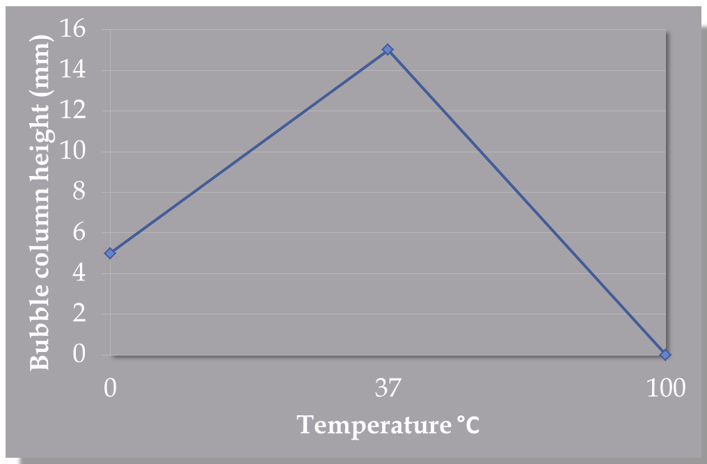
Effect of Temperature on Enzyme Activity

Slide 10
pH
Hydrogen peroxide, catalase, and water pH 3
Hydrogen peroxide, catalase, and water pH 7
Hydrogen peroxide, catalase, and water pH 11
What pH do you think catalase will work best? Think about what catalase does in your body
Concentration
Hydrogen peroxide and catalase
Hydrogen peroxide and increased amount of catalase (more than tube 1)
Hydrogen peroxide and increased amount of catalase (more than tube 2)

Slide 11
The Scientific Process
Think about your observations and previous knowledge on enzyme activity; what can cause proteins to denature?
What is your hypothesis for each experiment?
Follow the directions for each experiment
If we were doing actual scientific research, we would perform these experiments over and over to gather a large amount of data and to hopefully eliminate instances where human error could have been a factor
Collect data
Write results for each in the appropriate table
What are your conclusions?

