Slide 1
Cell Structure and physiology
BSC 2010 L

Slide 2
Cells
Cells are the basic unit of life
Cell Theory
All living things are composed of cells and
Cells come only from other cells

Slide 3
Cells
In this lab, we will look at a couple different things:
Cell Structure (Lab 4.0-4.2)
Difference between prokaryotes and eukaryotes
Eukaryotes – difference between plant and animal cells
Function of organelles
pH (Lab 4.5)
Well-being of cells also depends upon pH surrounding them
We will look at how a buffer can maintain pH within a narrow range and how buffers within cells can protect them from damaging pH changes
DNA Extraction (Lab 11.4)
The genetic makeup of a cell is contained in its DNA
We will look at the steps required to isolate and visualize DNA from cells

Slide 4
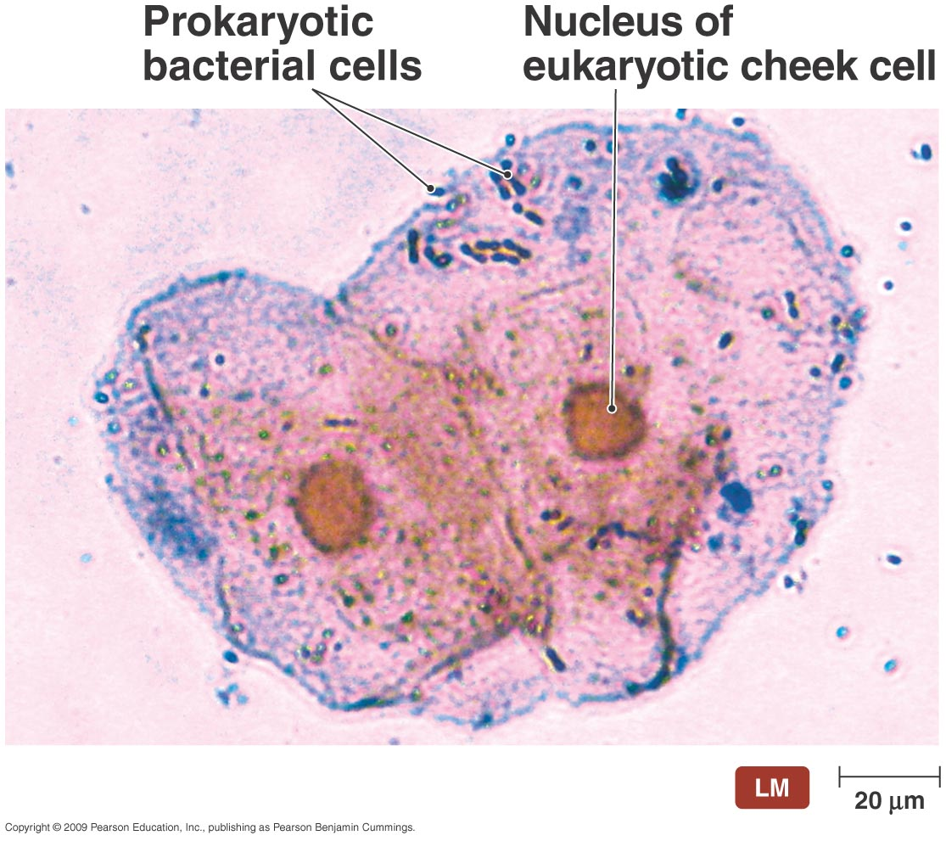
Prokaryotic cell
Eukaryotic Cell
Bacteria
Protists, fungi, plants, animals

Slide 5
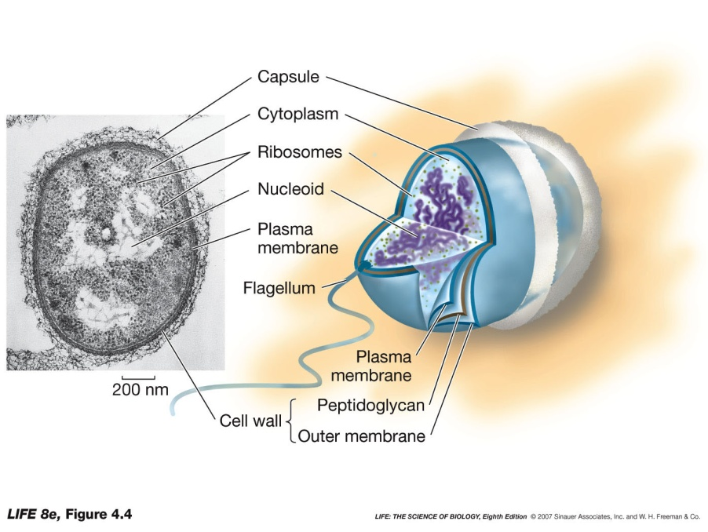
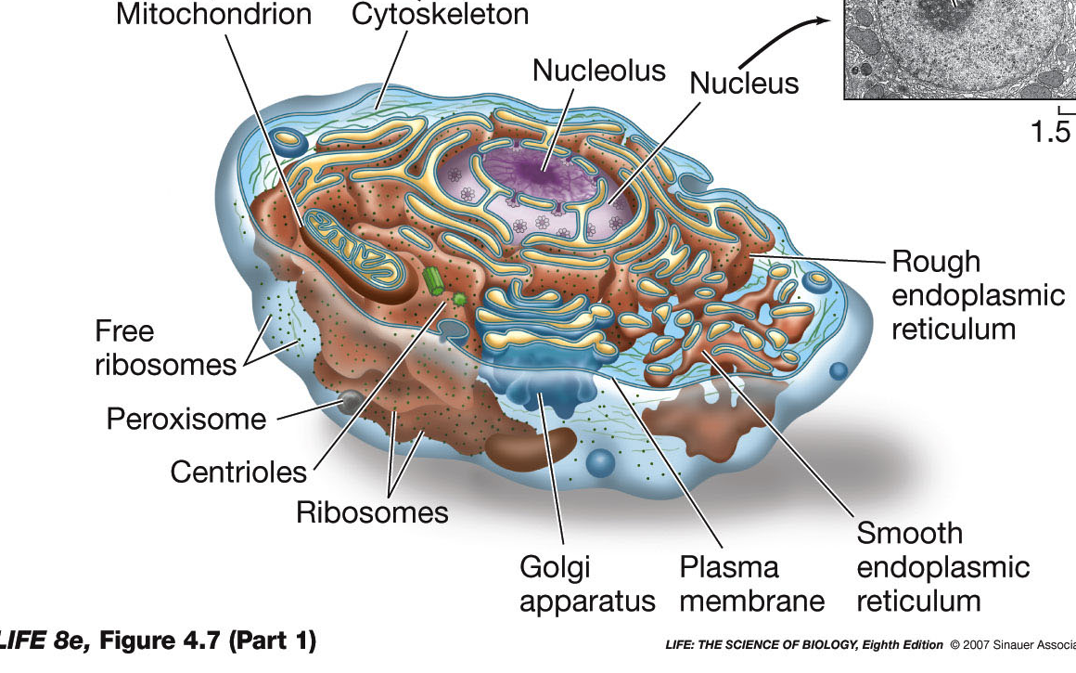
Prokaryotic cell
Eukaryotic Cell

Slide 6
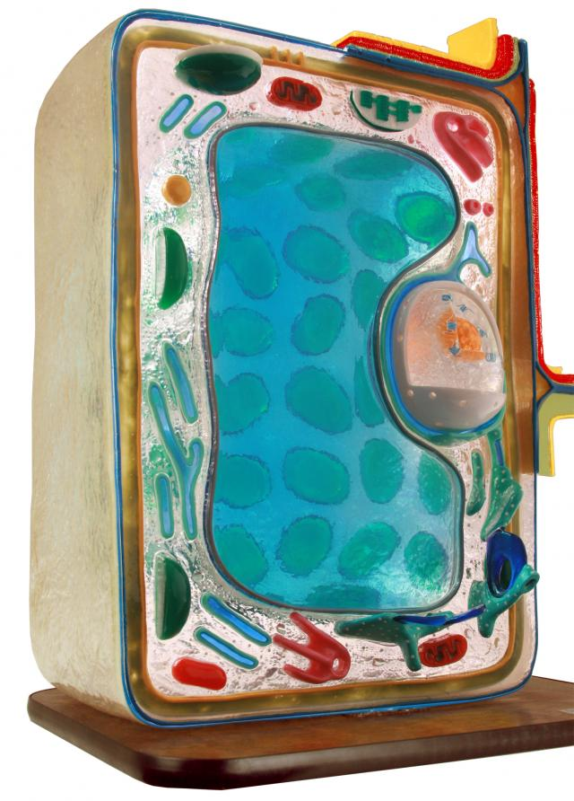
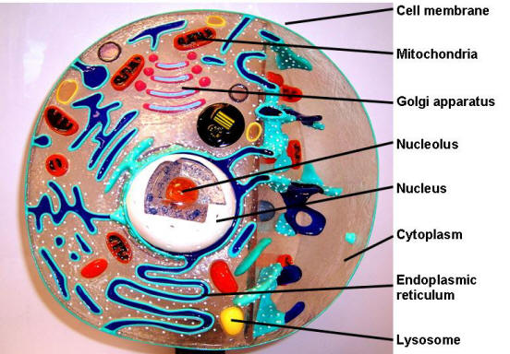
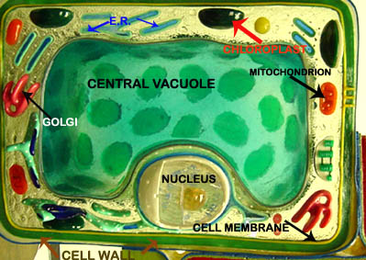
Eukaryotic Cells
Know the name and function of organelles found in eukaryotic cells
Know differences between plant cells and animal cells!

Slide 7
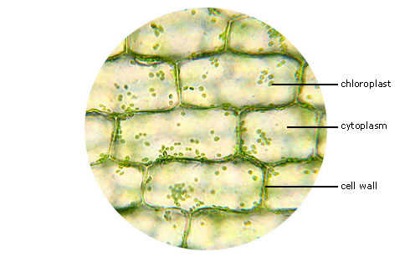
Living Plant Cells
Looking at the Elodea Leaf

Slide 8
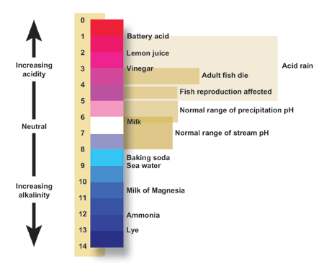
pH
pH of a solution tells its hydrogen ion concentration - H+
Buffer – system of chemicals that takes up excess H ions or hydroxide ions
Maintaining pH is VERY important in biological systems
i.e. – human blood pH must be maintained at 7.4
Exercise 4.5
You will test the buffering capacity of 3 solutions
Water, buffer, albumin
Which one do you think will be able to hold its pH the longest as drops of HCl are added and why

Slide 9
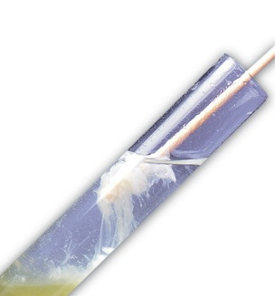
DNA Extraction
DNA
Deoxyribonucleic acid
Genetic material of cells
DNA Extraction Steps (Experiment 11.4)
Homogenization
Deproteinization
Precipitation
Spooling DNA
http://www.lofstrand.com/images/dna_ext.jpg

